Slide 1
What We Know
3:26PM 911 Called
3:56PM Metro Detective Arrives
4:14PM Metro ID Tech Arrives

Slide 2
What we can reasonably conclude
4:15 to 4:35
  Area is Secured
  Area Taped Off
  Traffic Rerouted
  Site Secured For Measurements and Pictures

Slide 3
What seems clear
Between 4:34PM and 4:44PM
Which is between 70 minutes and 80 minutes after the accident ID Tech takes Picture of Area with Water

Slide 4
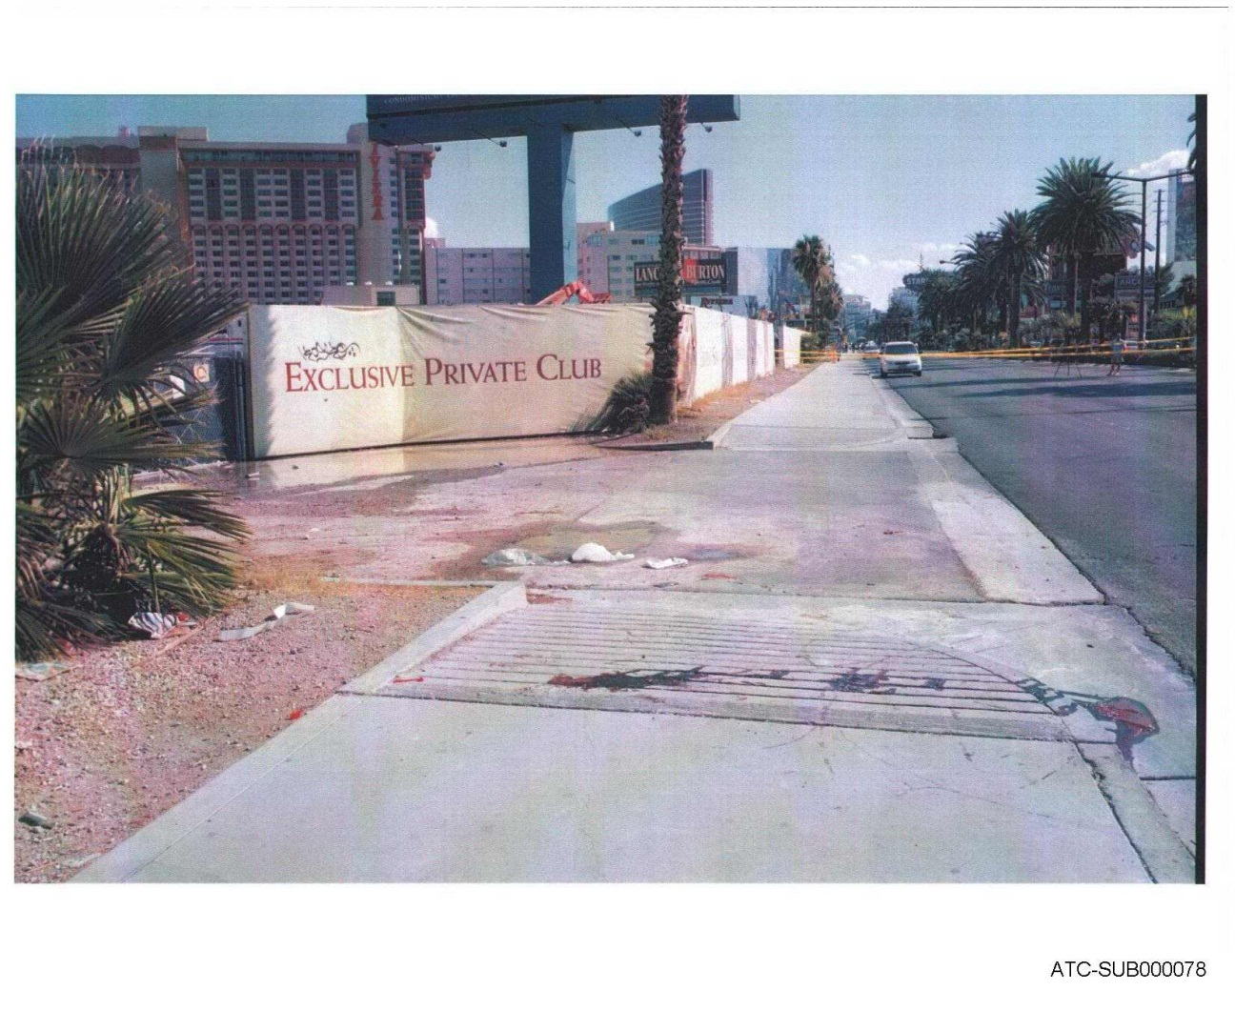
Picture 1655

Slide 5
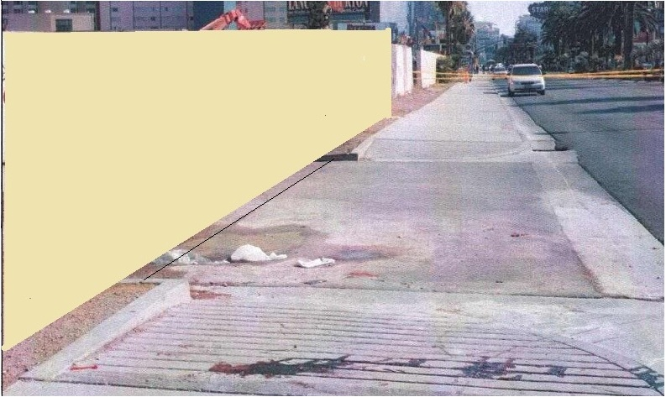
Picture 1655 Cropped

Slide 6
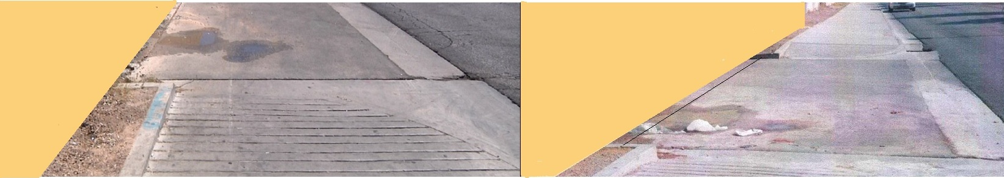
Water test photo next to Picture 1655

Slide 7
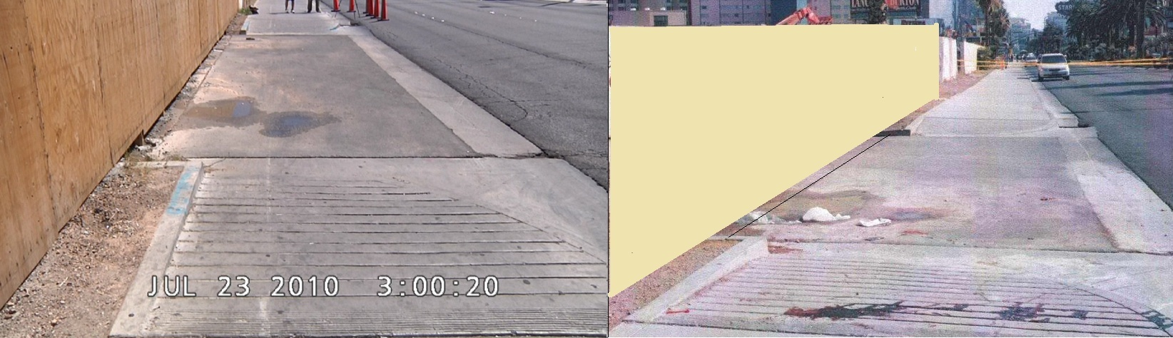
1 hour 15 minutes after accident

Slide 8
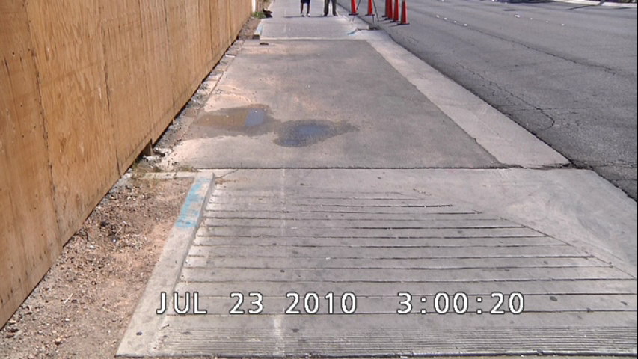
1 hour 15 minutes after accident

Slide 9
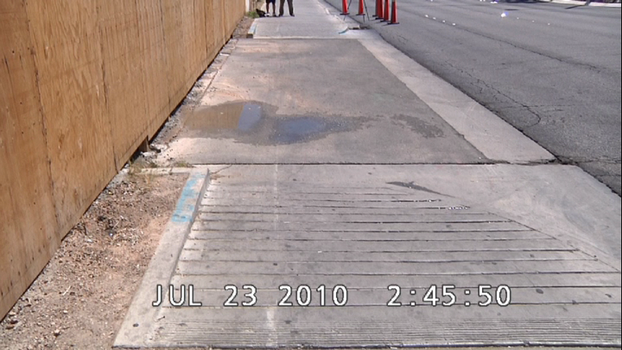
1 hour after accident

Slide 10
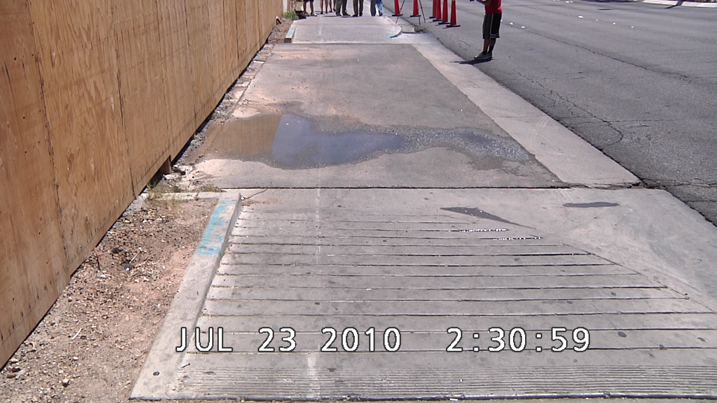
45 minutes after accident

Slide 11
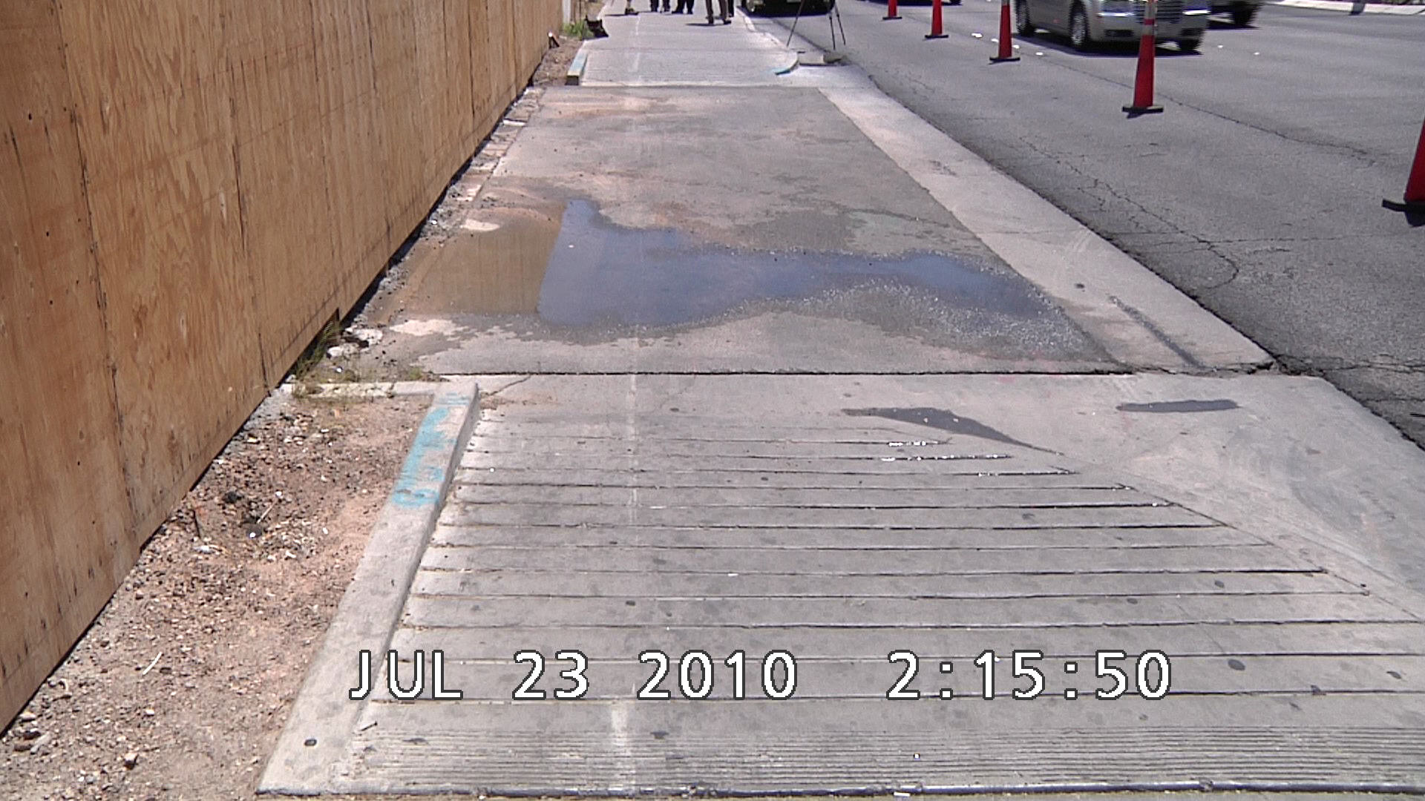
30 minutes after accident

Slide 12
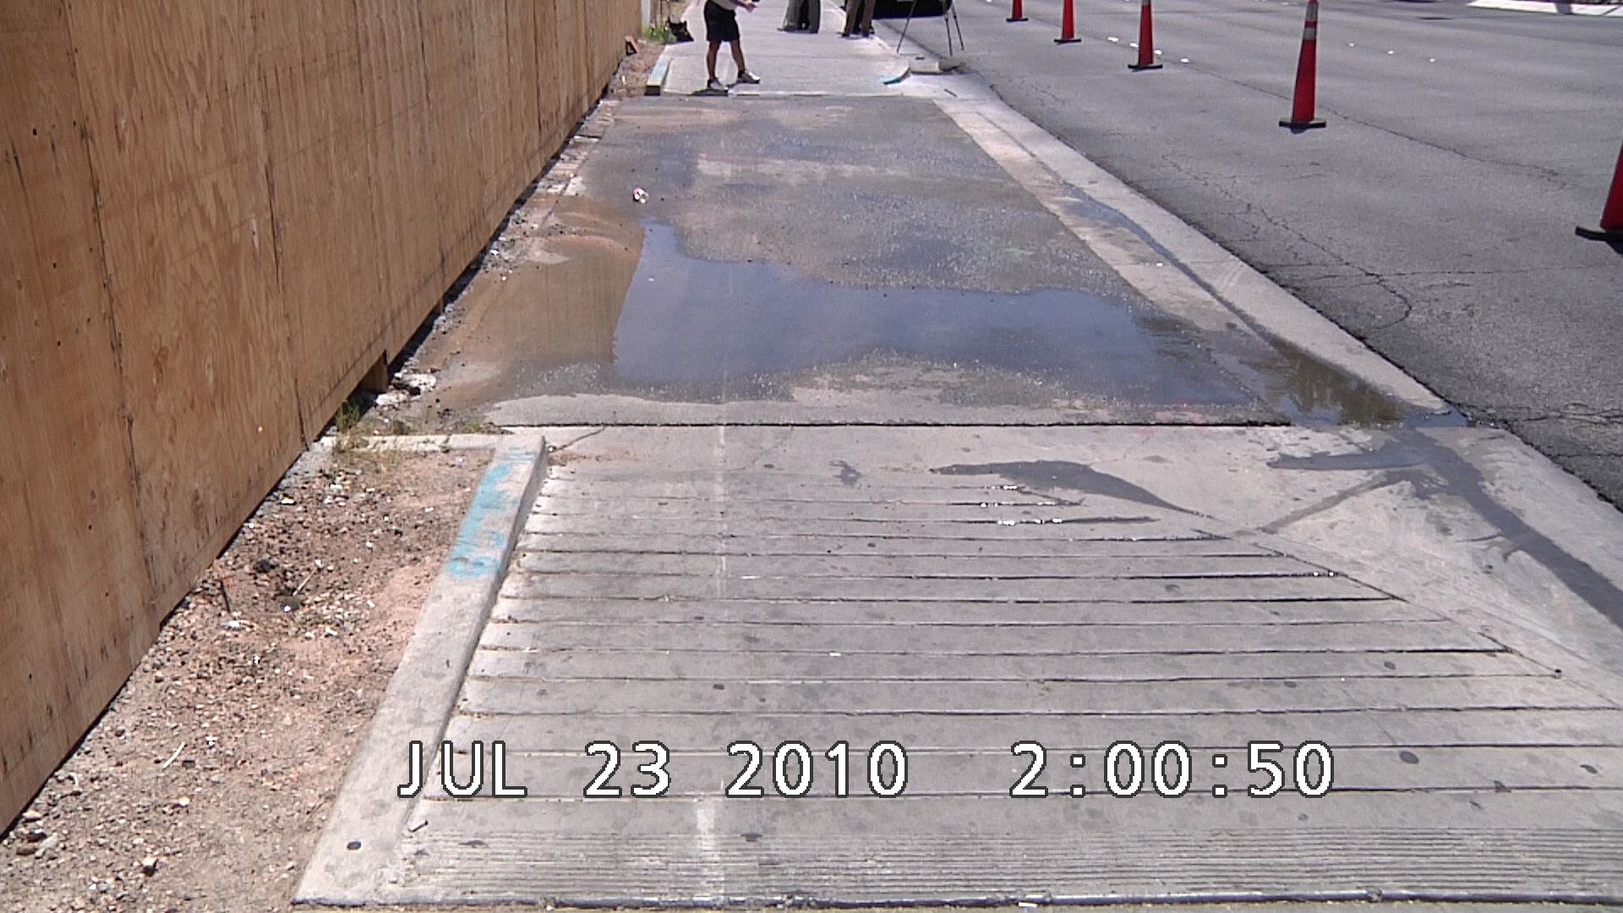
15 minutes after accident

Slide 13
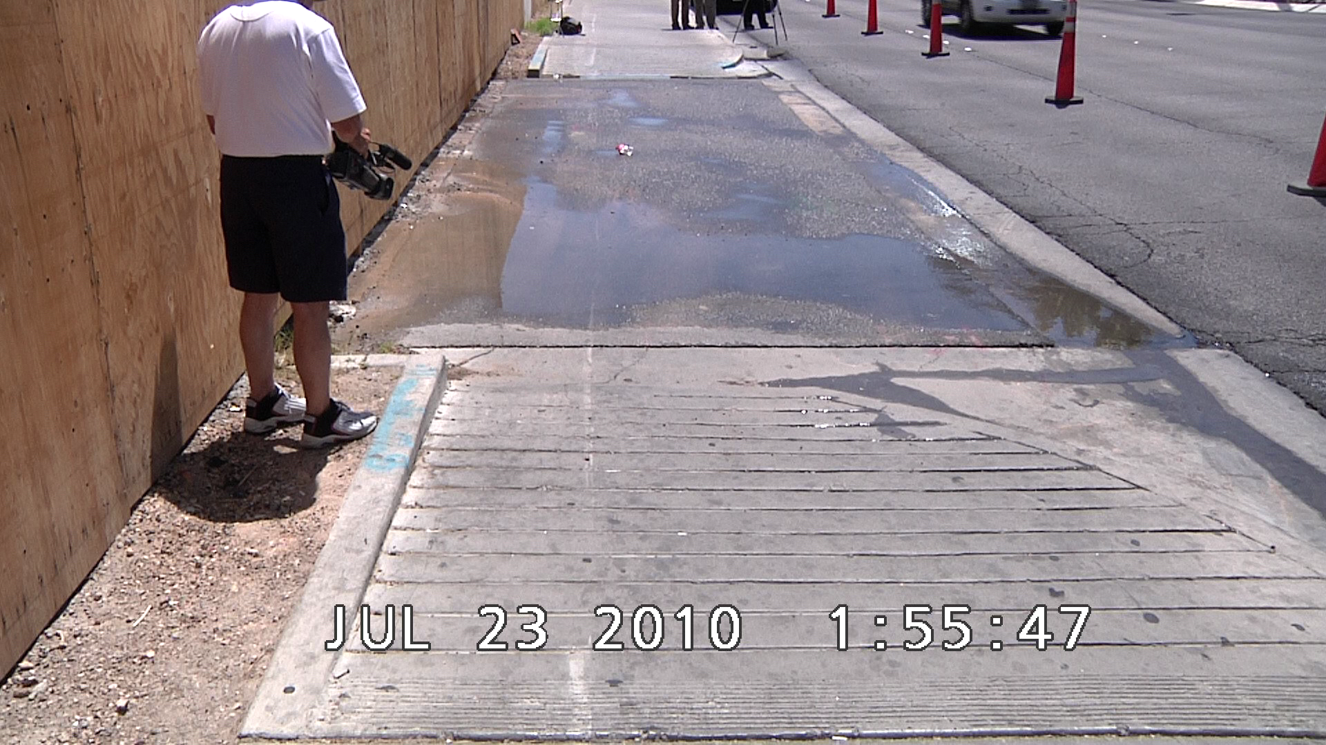
10 minutes after accident

Slide 14
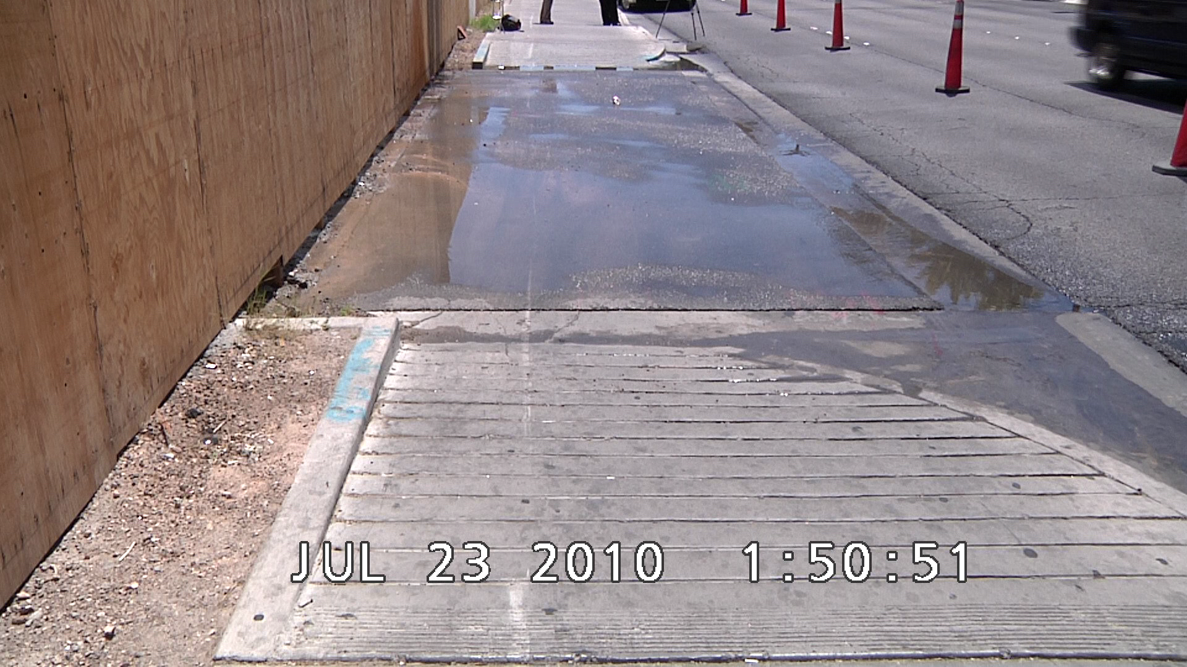
5 minutes after accident

Slide 15
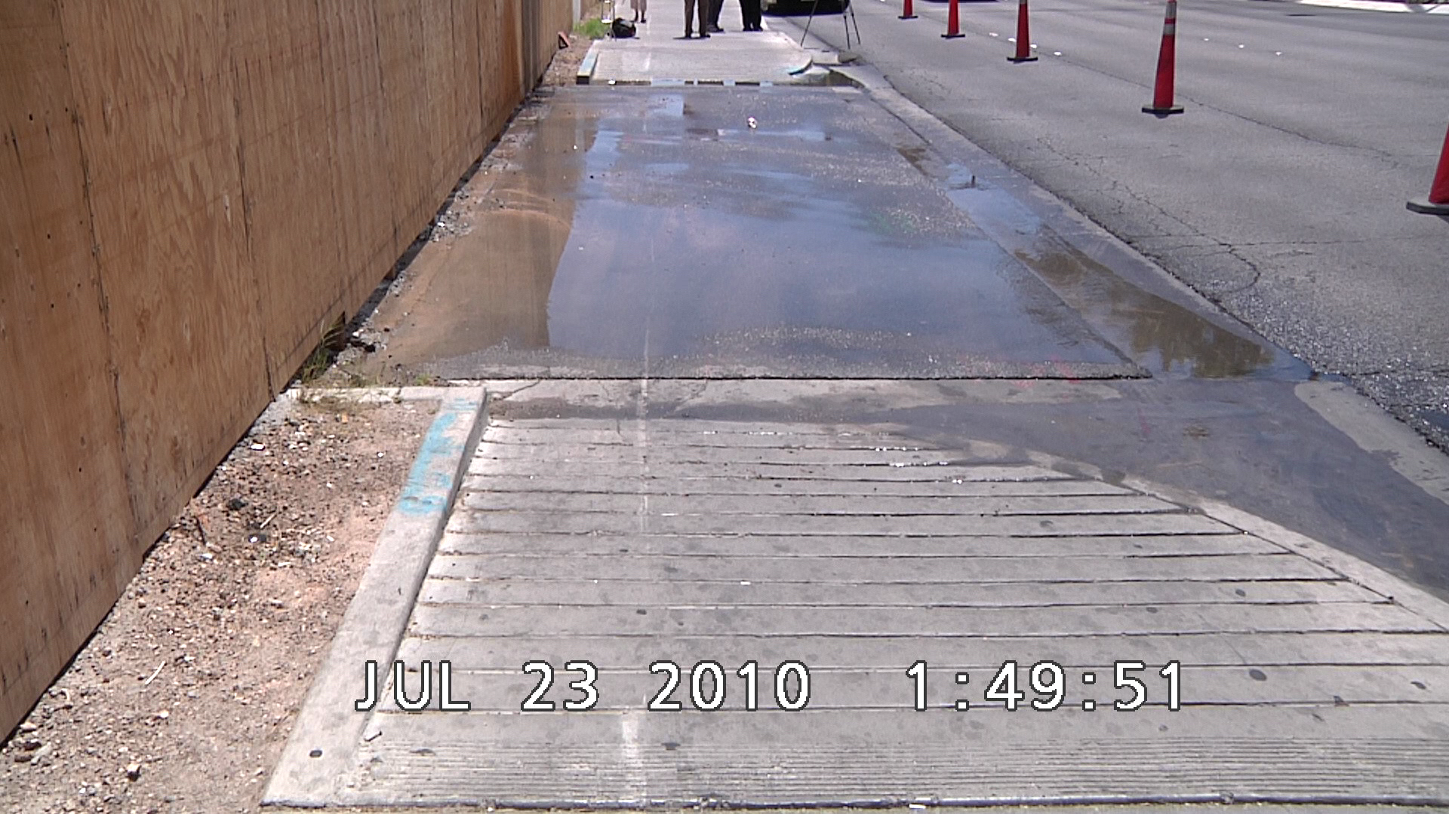
4 minutes after accident

Slide 16
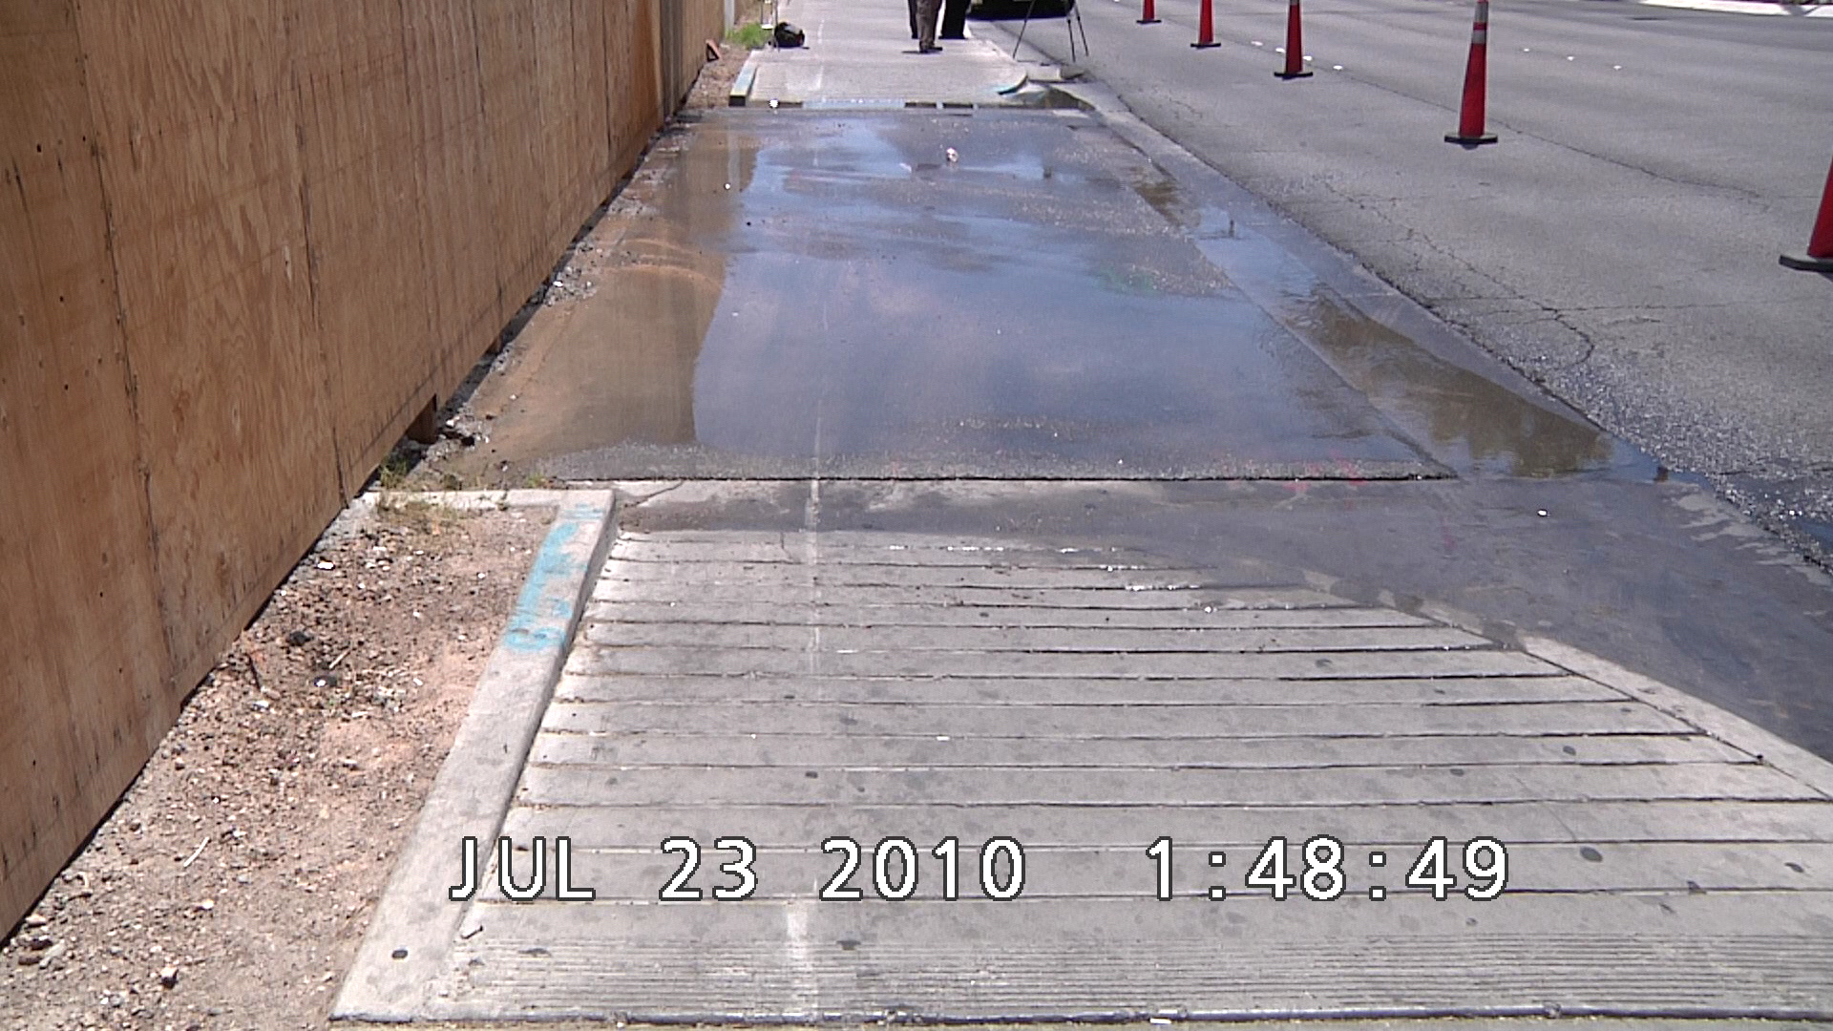
3 minutes after accident

Slide 17
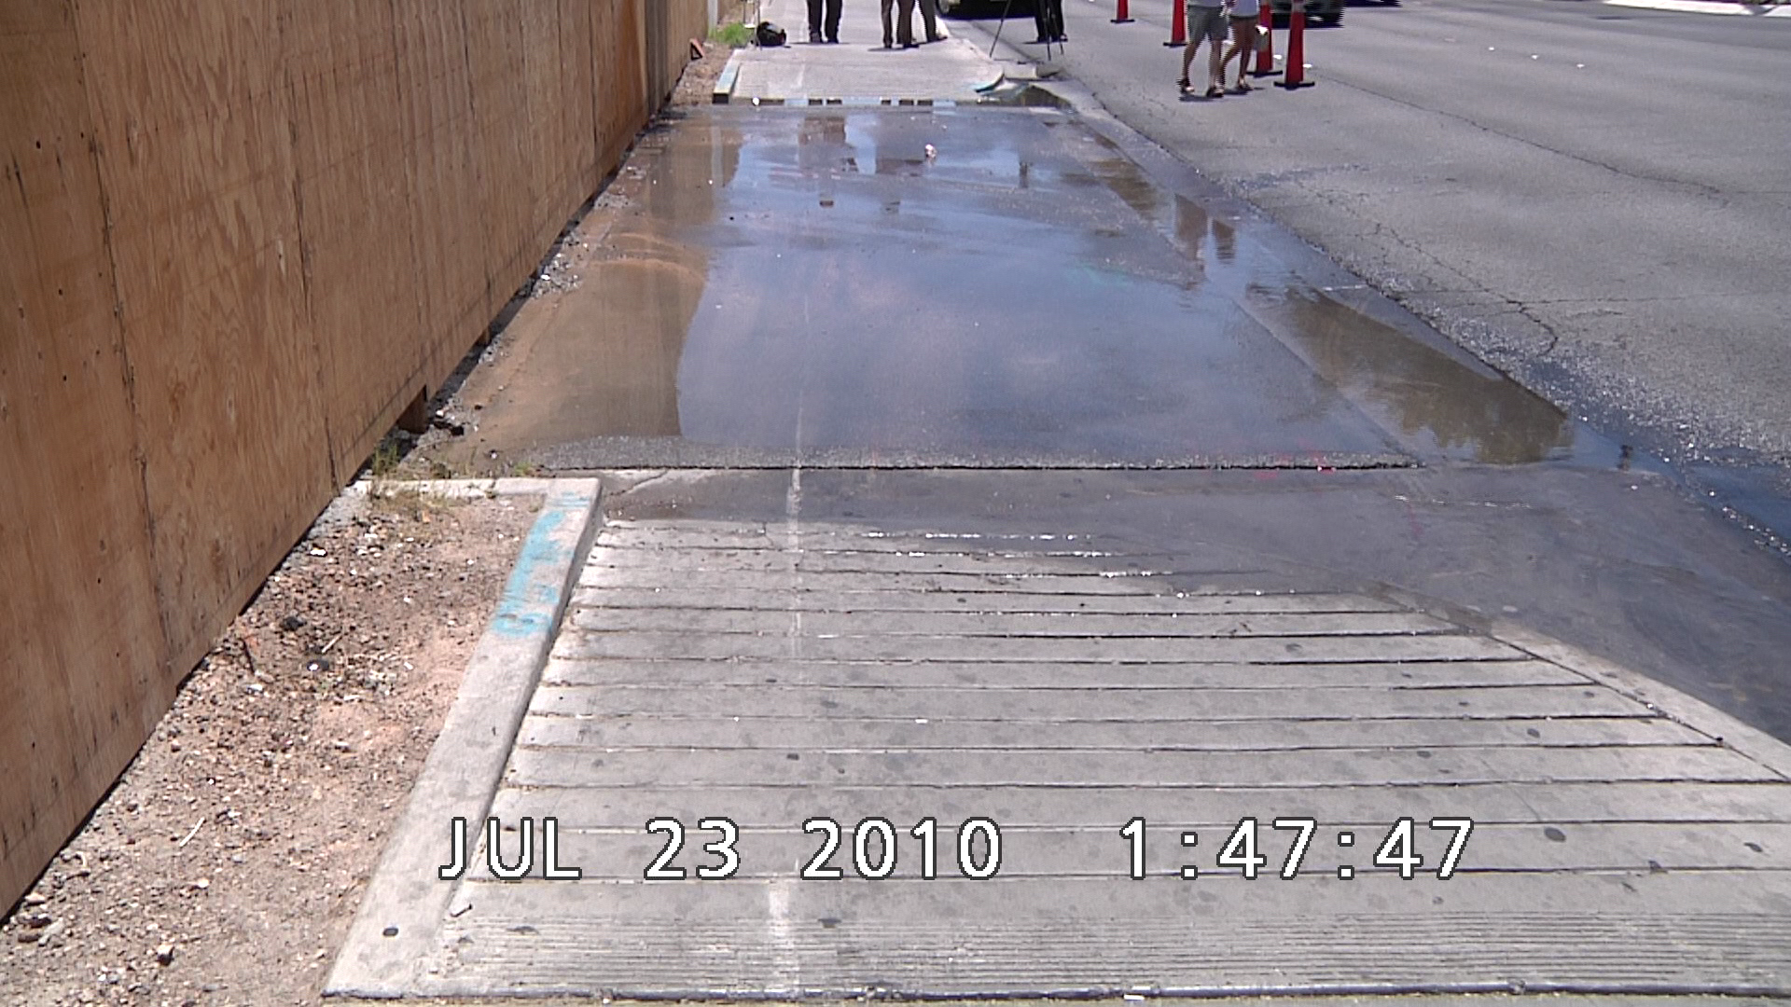
2 minutes after accident

Slide 18
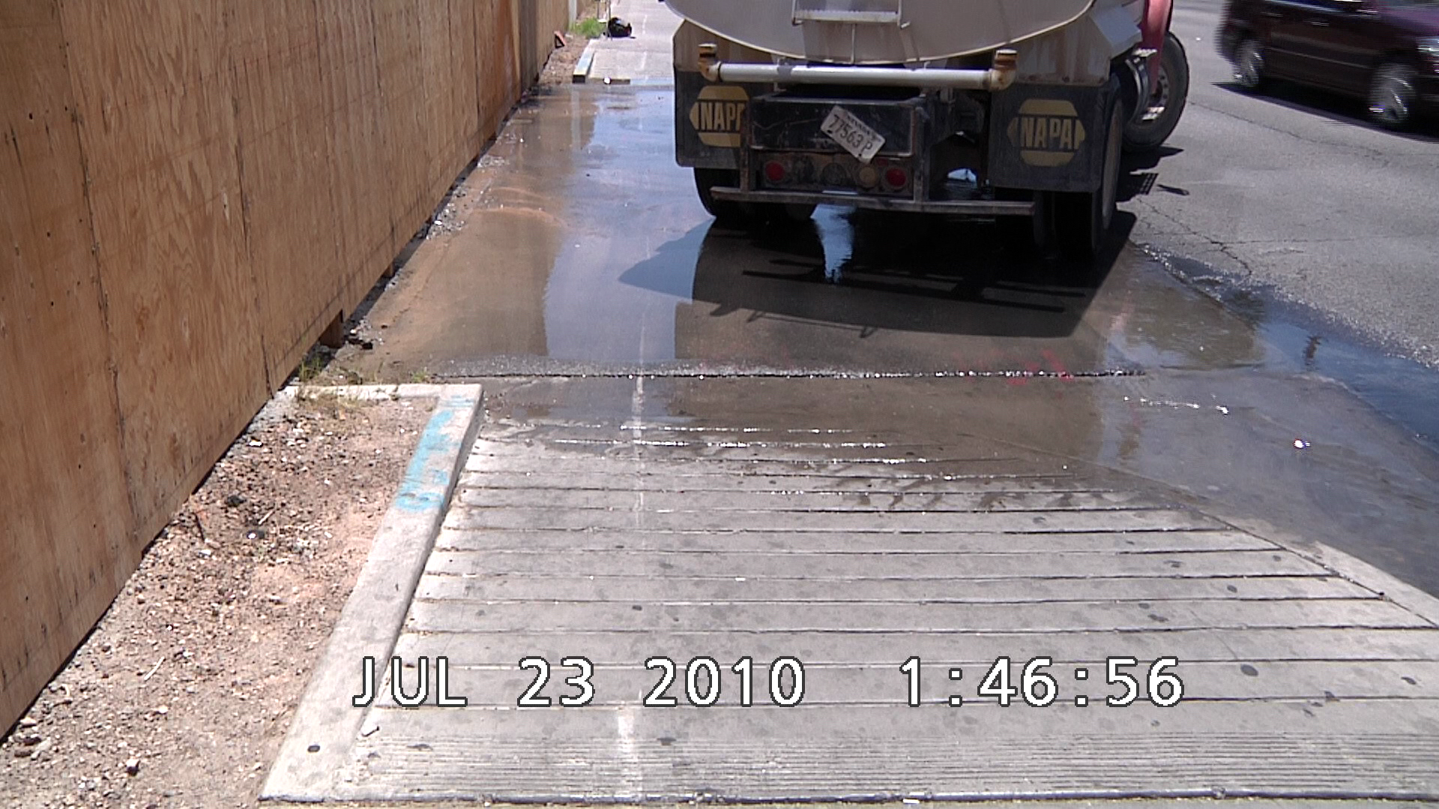
1 minute after accident

Slide 19
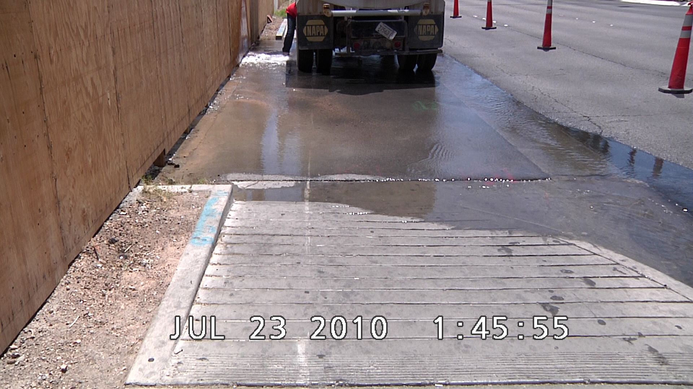
Scene at time of accident

Slide 20
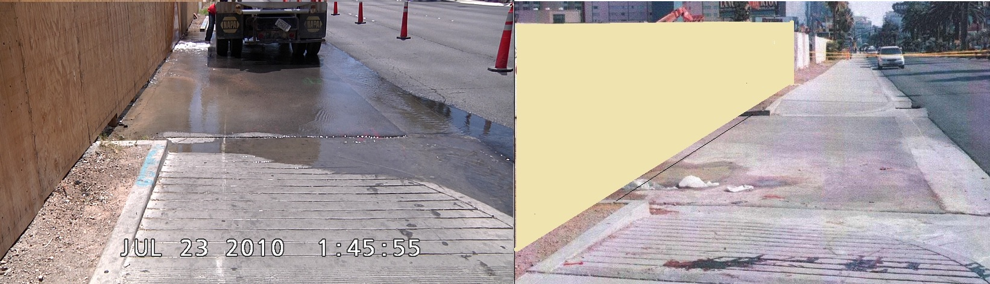
Scene at time of accident

Slide 21
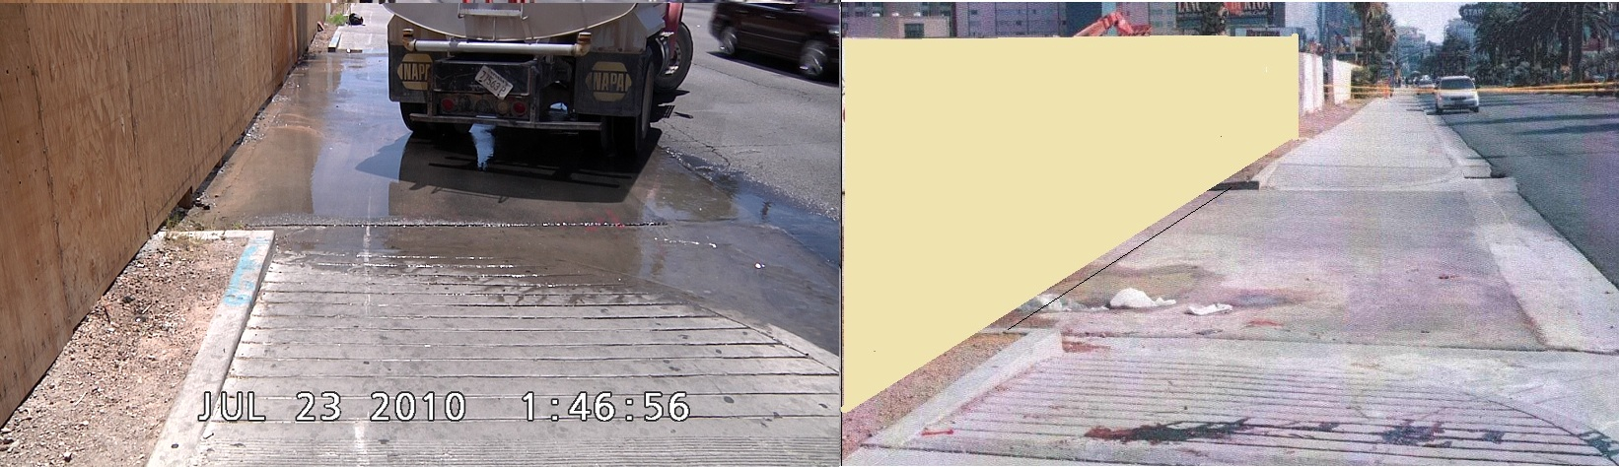
1 minute after accident

Slide 22
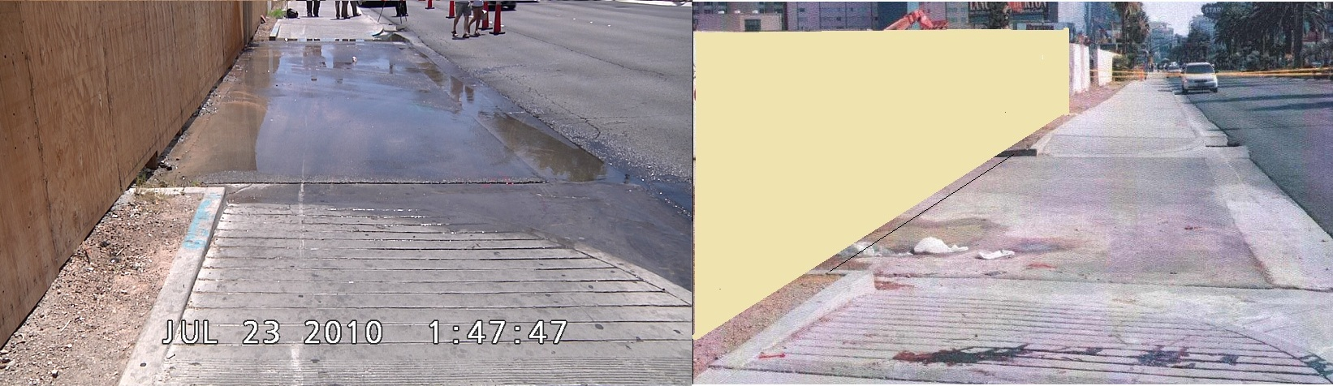
2 minutes after accident

Slide 23
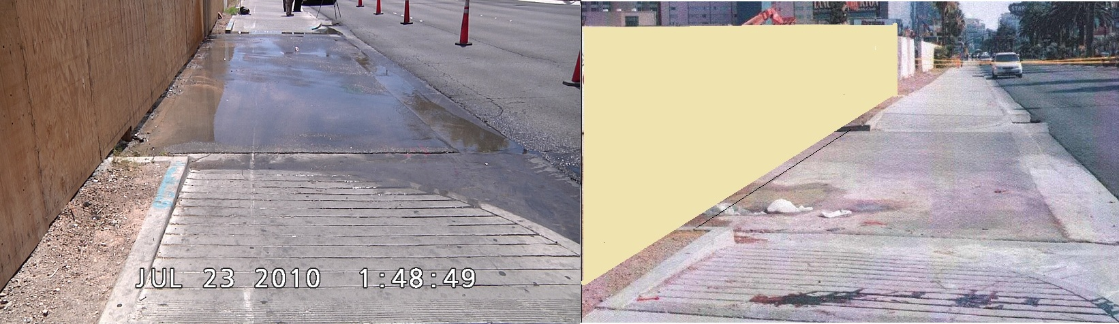
3 minutes after accident

Slide 24

4 minutes after accident

Slide 25
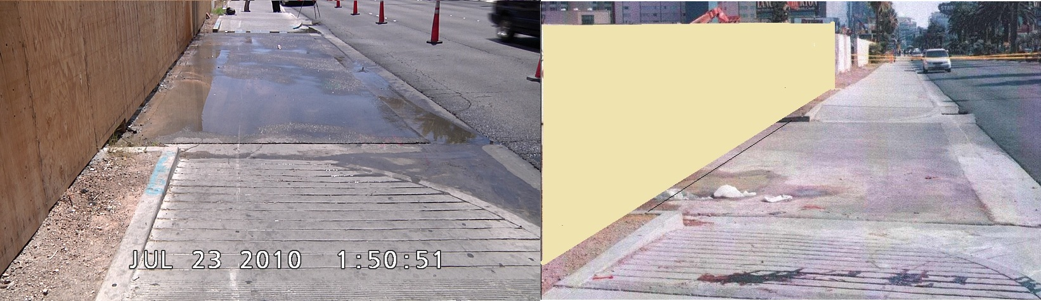
5 minutes after accident

Slide 26
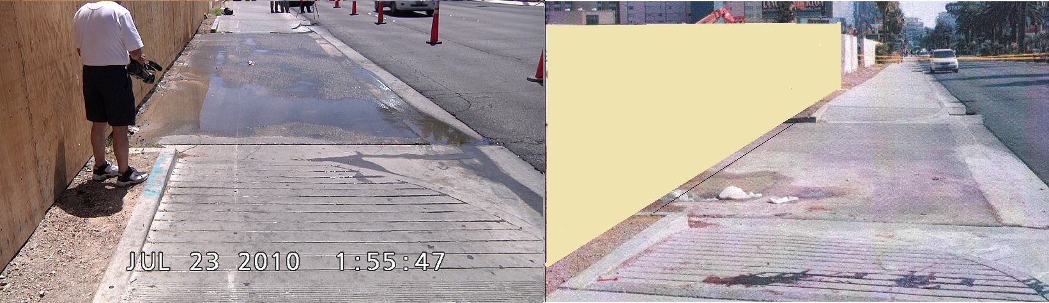
10 minutes after accident

Slide 27
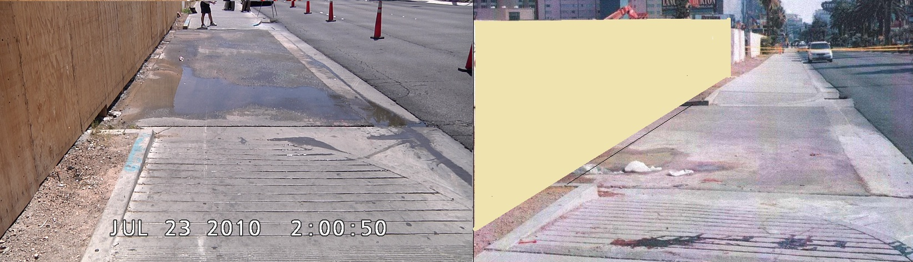
15 minutes after accident

Slide 28
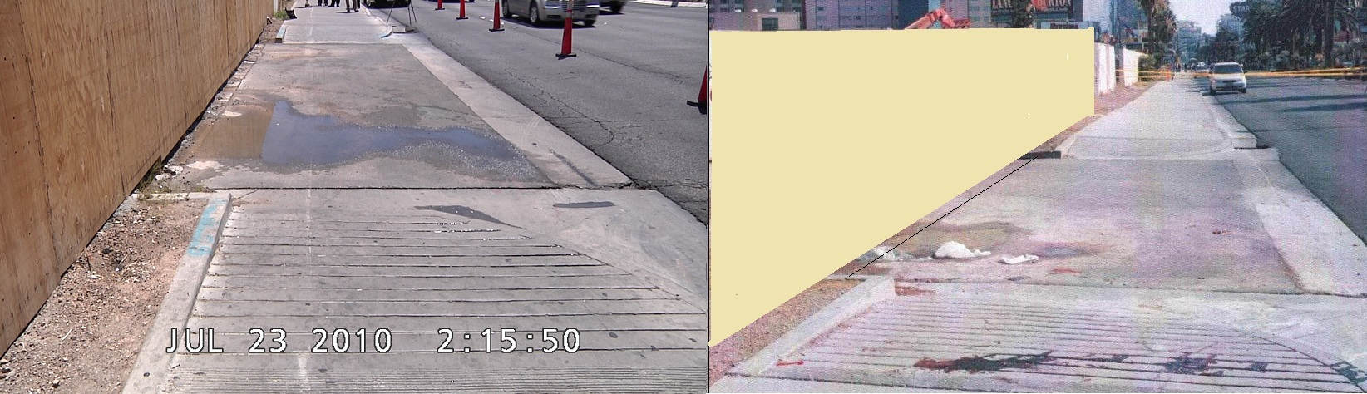
30 minutes after accident

Slide 29
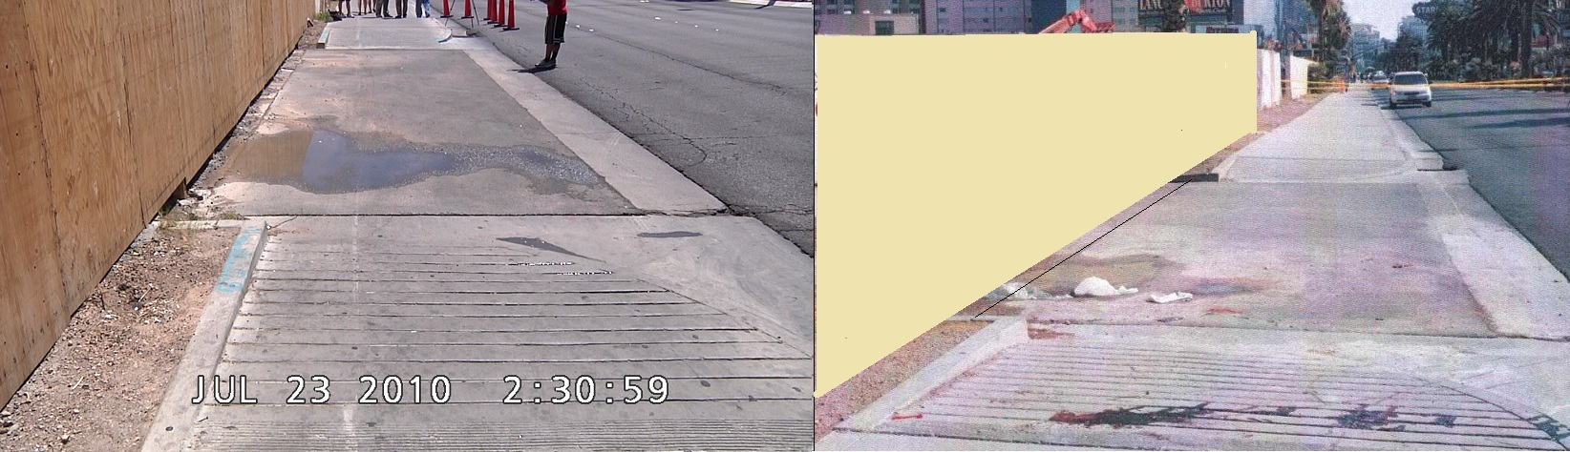
45 minutes after accident

Slide 30
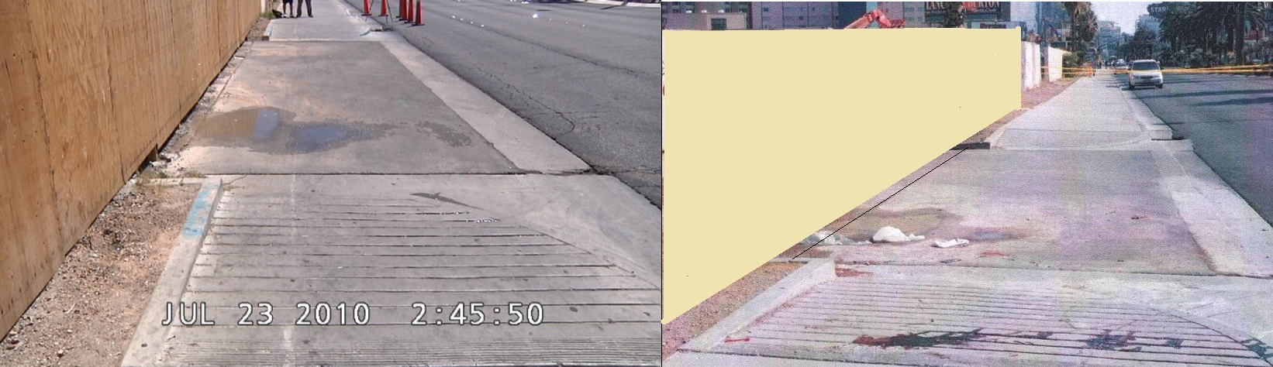
1 hour after accident

Slide 31
1 hour 15 minutes after accident

Slide 32
Now we know this

Slide 33
Caused this

